Slide 1




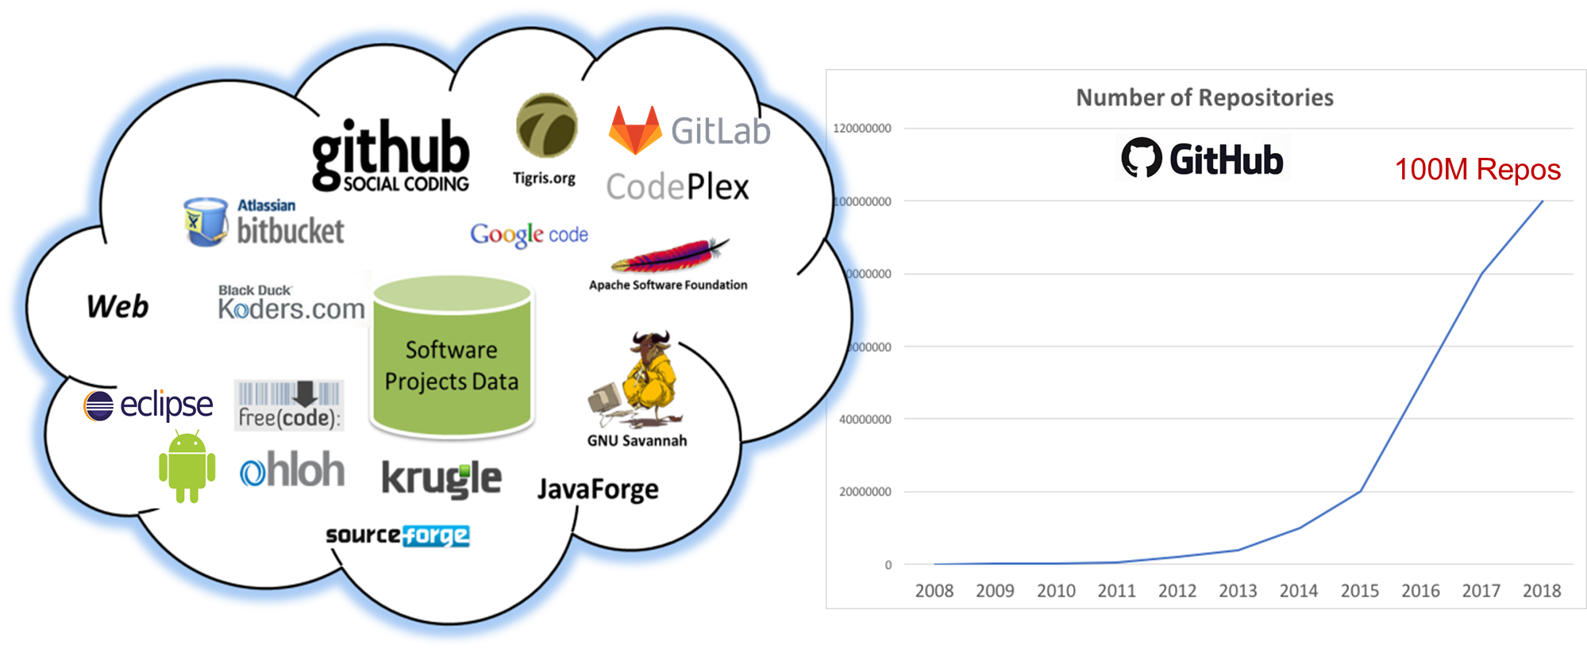
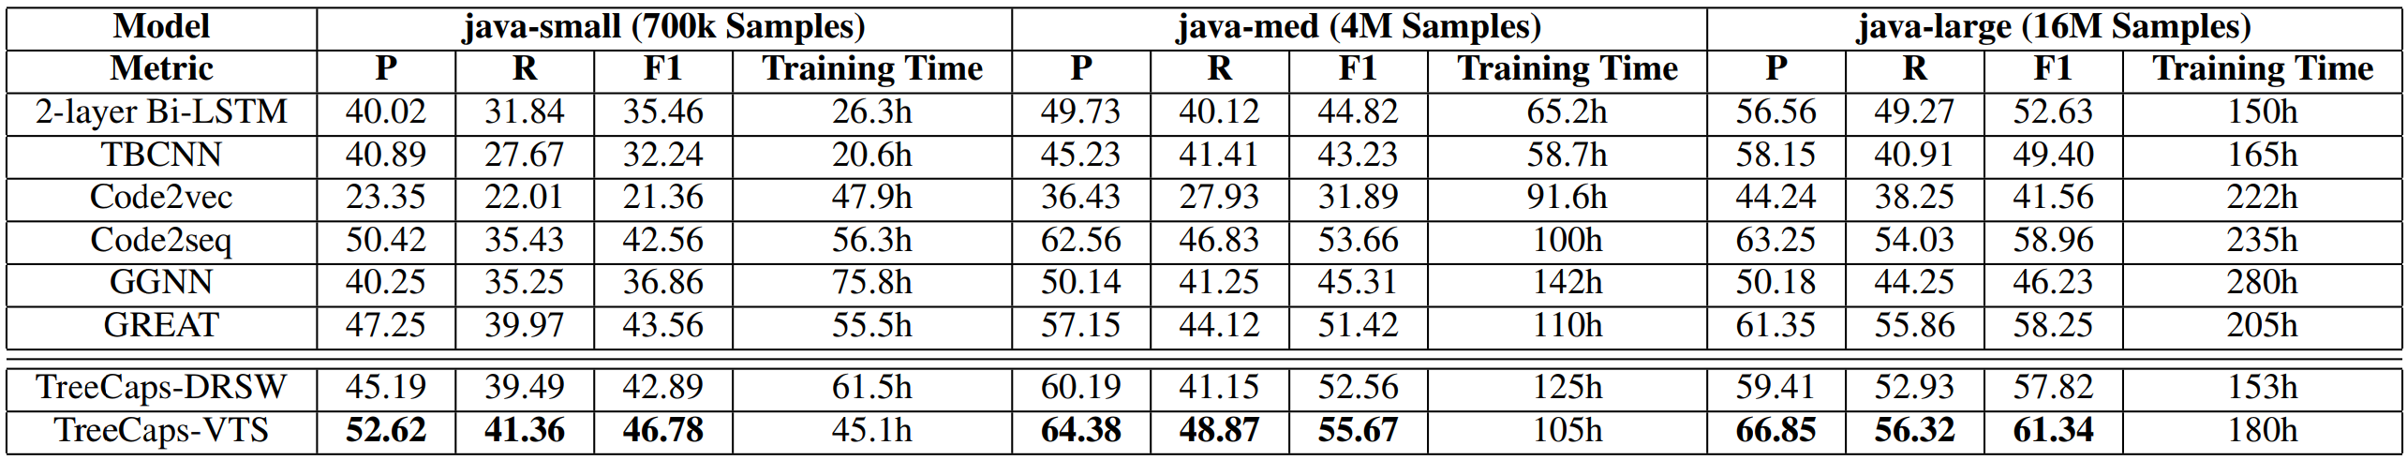
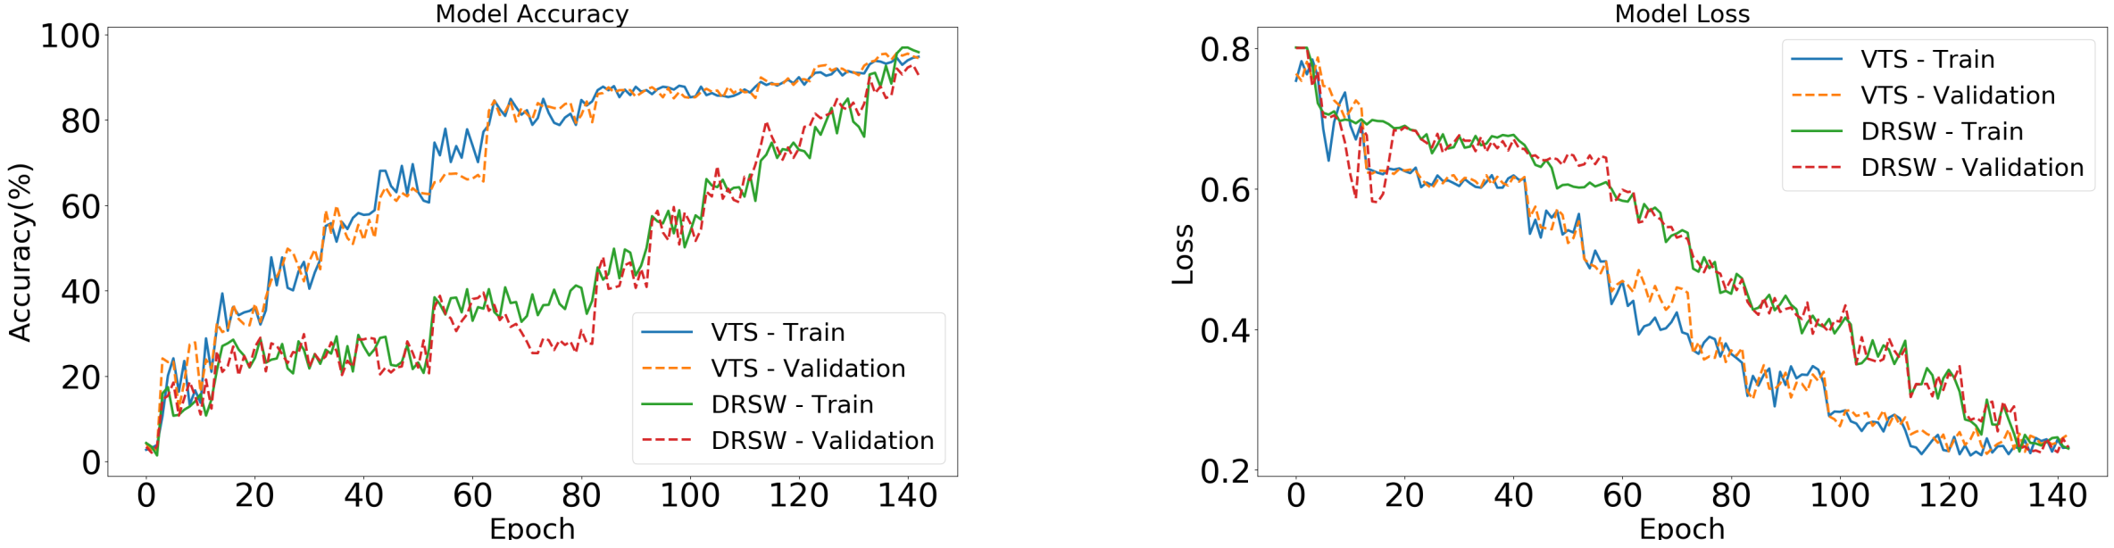
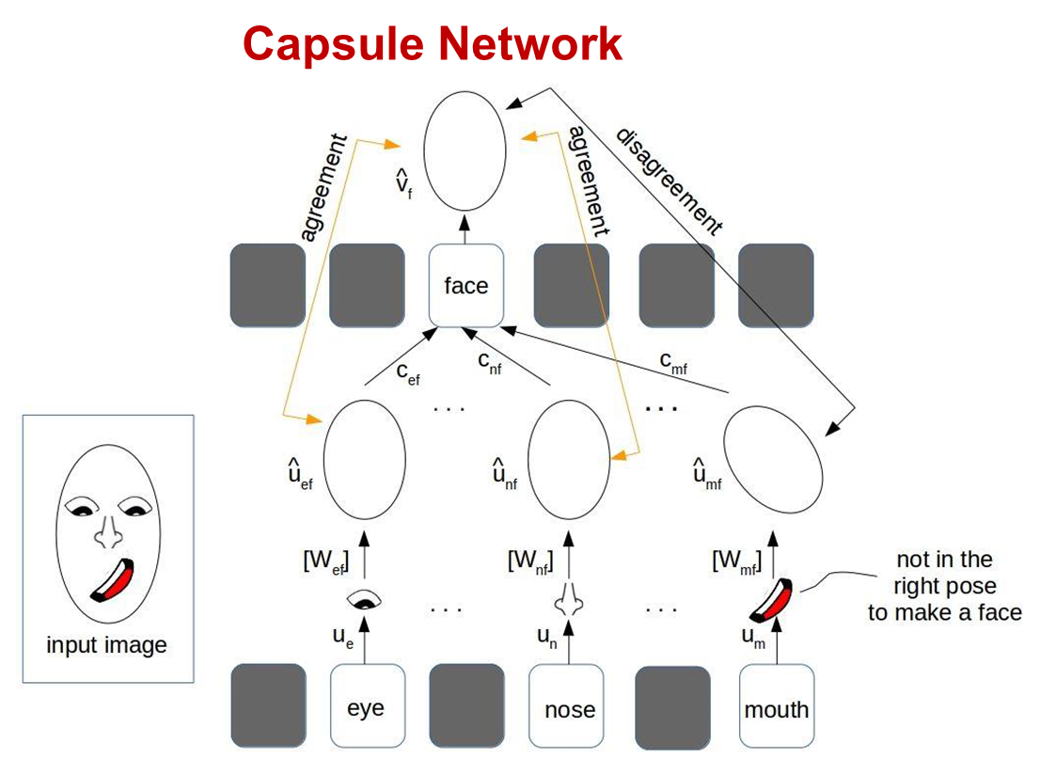
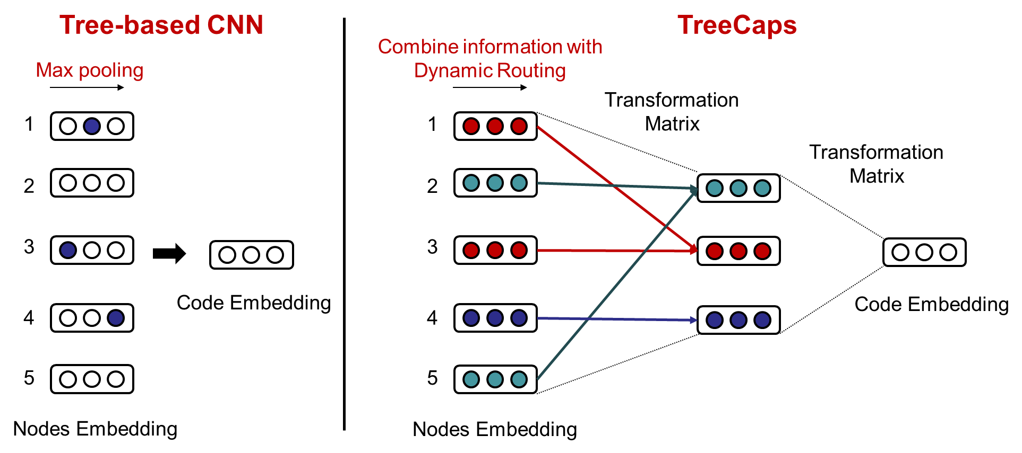
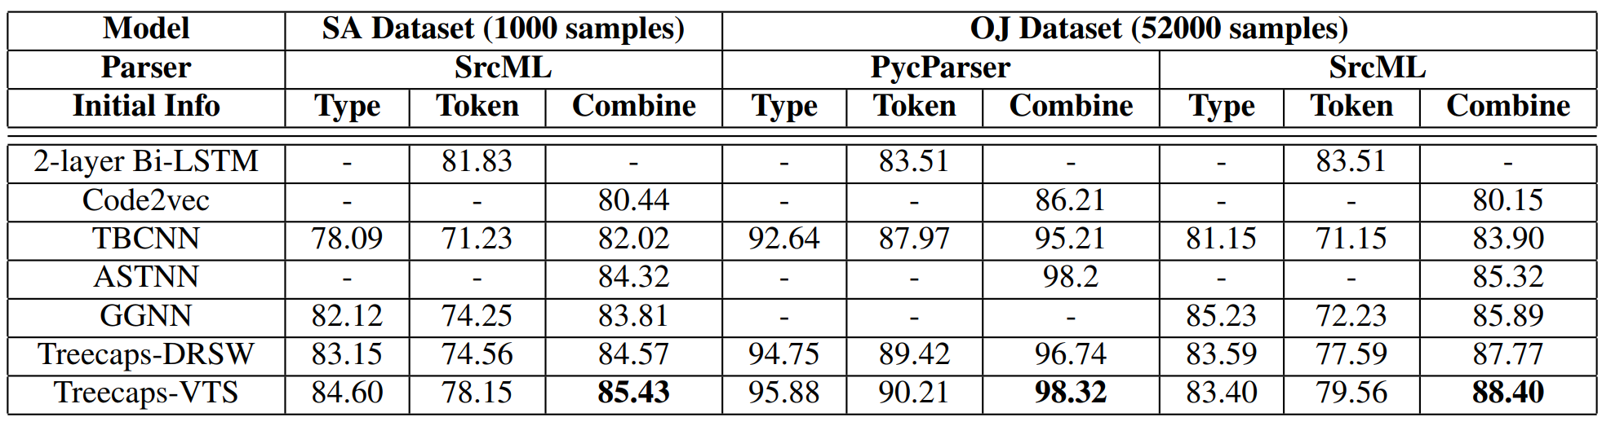
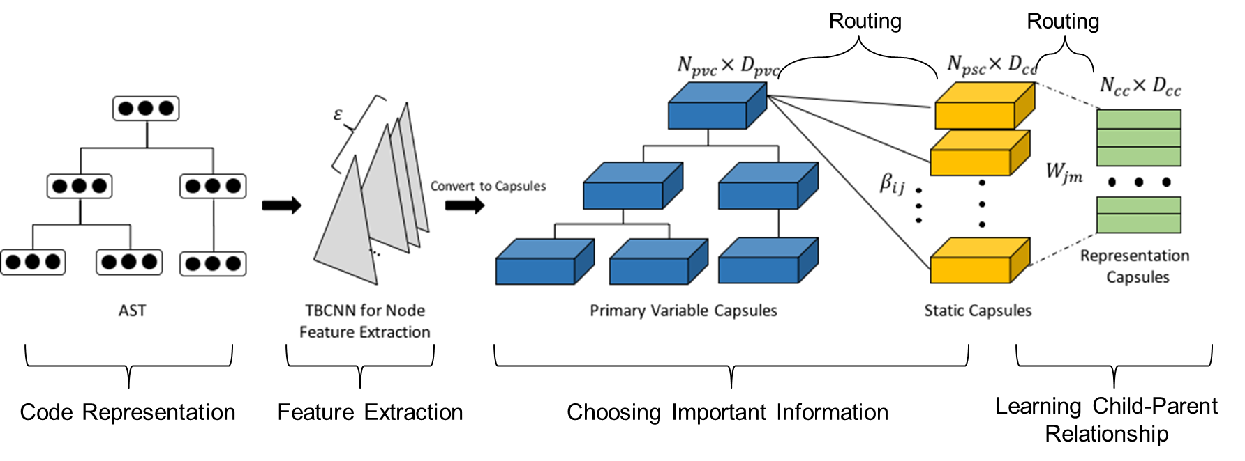
TreeCaps: Tree-Based Capsule Networks for Source Code Processing
Nghi D.Q Bui(*), Yijun YU(**), Lingxiao Jiang(*)
(*) School of Computing and Information Systems, Singapore Management University
(**) School of Computing & Communications, The Open University, UK
Motivation
Empirical Evaluations
Code reuse, search, analysis, repair, refactoring, synthesis for improving software quality, developer productivity and reducing costs.
Need of deep learning models of code to support intelligent software engineering tools.
Existing models are insufficient and inefficient in capturing code syntax, context, or semantics.
Sequence-based models encode lexical meaning of tokens while missing structures and semantics.
Tree-based models miss code dependencies.
Graph-based models rely on unsound program analysis and expensive graph-based learning.
TreeCaps achieve better Function Name Prediction performance than other sequence-, tree-, graph-based baselines.
Source code
Test cases
Bug reports
Change histories
Discussions
Developer social network
……
Goal & Main Idea
Design an efficient and effective code models based on abstract syntax trees without inaccurate program analysis, while capturing code dependencies.
TreeCaps with Variable-to-Static Routing
TreeCaps achieve better Functionality Classification performance.
Key technical challenges:
Tree-based convolutions
Varying sizes of trees
Different programming languages
Diverse downstream tasks
Sample training tasks:
Code Functionality Classification – SA dataset (Bui et al. 2019) 1000 Java programs in 10 Sorting Algorithms and OJ Dataset (Mou et al. 2016) 52000 C programs of 104 classes
Function Name Prediction - Java-Small (700k functions), Java-Med (4M functions), Java-Large (16M functions) (Alon et al. 2019)
References
(Mou et al. 2016) Lili Mou, Ge Li, Lu Zhang, Tao Wang, Zhi Jin. Convolutional neural networks over tree structures for programming language processing. In 30th AAAI, 2016
(Alon et al. 2019) Uri Alon, Shaked Brody, Omer Levy, Eran Yahav. code2seq: Generating Sequences from Structured Representations of Code. In ICLR 2019.
(Bui et al. 2019) Nghi D. Q. Bui, Yijun Yu, Lingxiao Jiang. SAR: Learning Cross-Language API Mappings with Little Knowledge. In 27th ESEC/FSE 2019.
(Bui et al. 2020) Nghi D. Q. Bui, Yijun Yu, Lingxiao Jiang. TreeCaps: Tree-based Capsule Networks for Source Code Processing. In AAAI 2021. https://arxiv.org/abs/2009.09777

